Slide 1
Distributed Deep Learning
Daniel Gordon

Slide 2
CAVEAT - I AM NOT A SYSTEMS GUY
But I did take a systems class once. I did a Paxos.

Slide 3
GOALS
Minimize Training Time
Maximize Throughput - Good for large datasets
Maximize Concurrency - Good for large clusters
Minimize Data Transfers
Maximize Batch Size - Good for when small batches are unstable
Maximize Network Depth
Minimize Latency - Good for deployment

Slide 4
GOALS
Minimize Training Time
Maximize Throughput - Good for large datasets
Maximize Concurrency - Good for large clusters
Minimize Data Transfers
Maximize Batch Size - Good for when small batches are unstable
Maximize Network Depth
Minimize Latency - Good for deployment

Slide 5
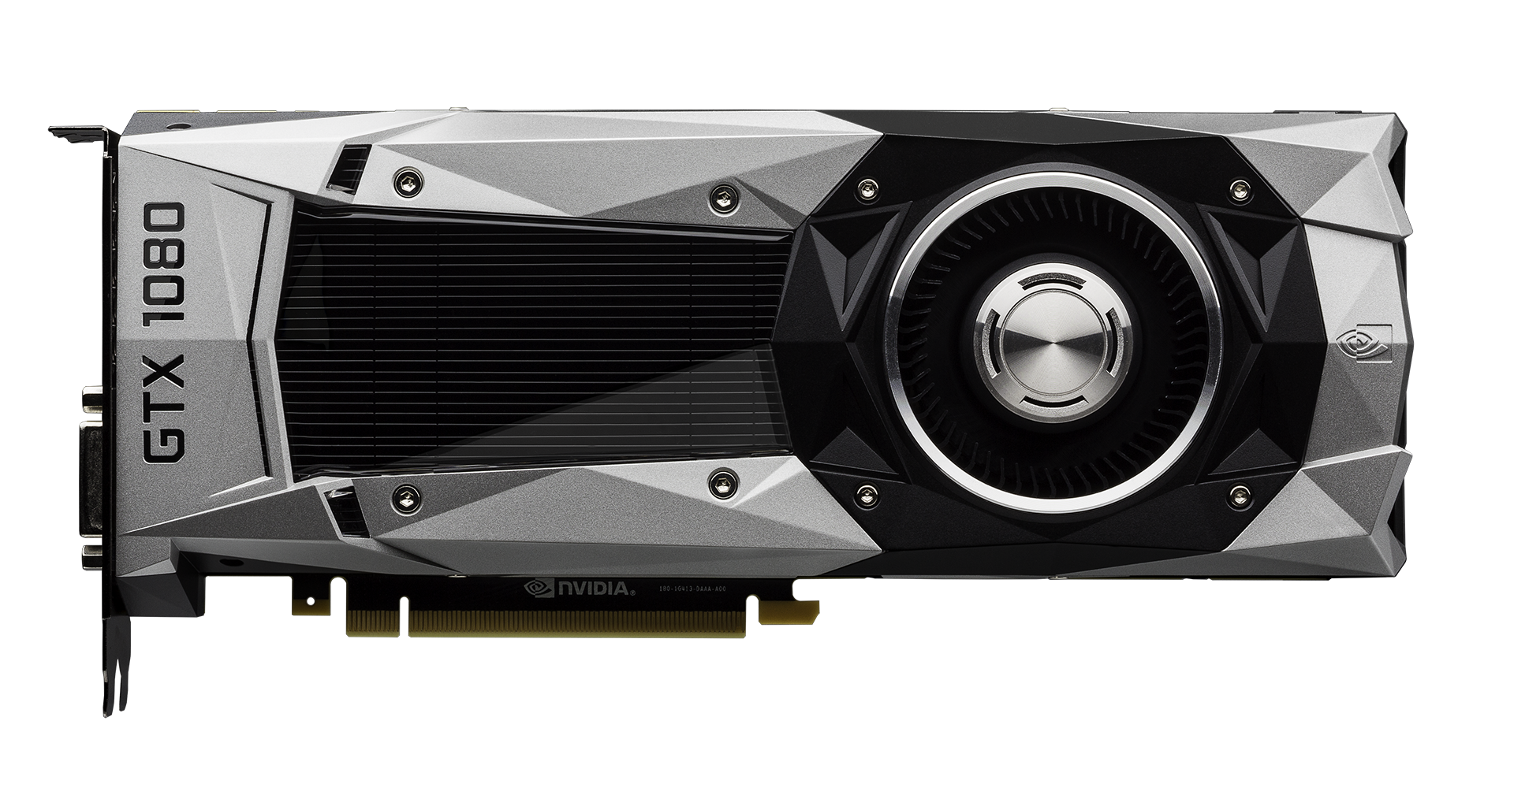
CORE IDEA...SIMPLE ENOUGH
Batch
Batch
Batch
NN
NN
NN
Batch
Batch
NN
NN

Slide 6
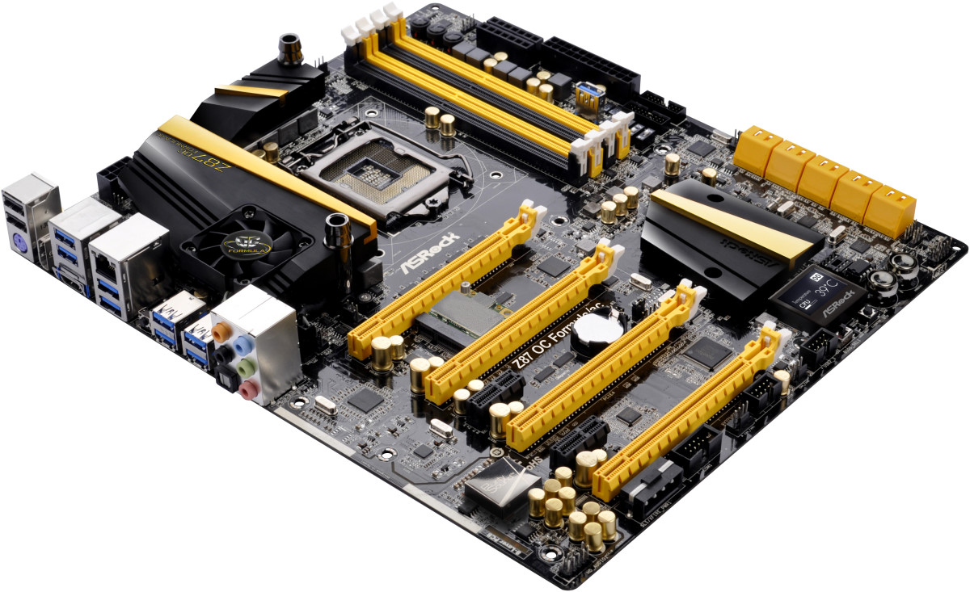
CORE IDEA SIMPLE ENOUGH
Batch
NN
Batch
Batch
Batch
Batch
NN
NN
NN
NN

Slide 7
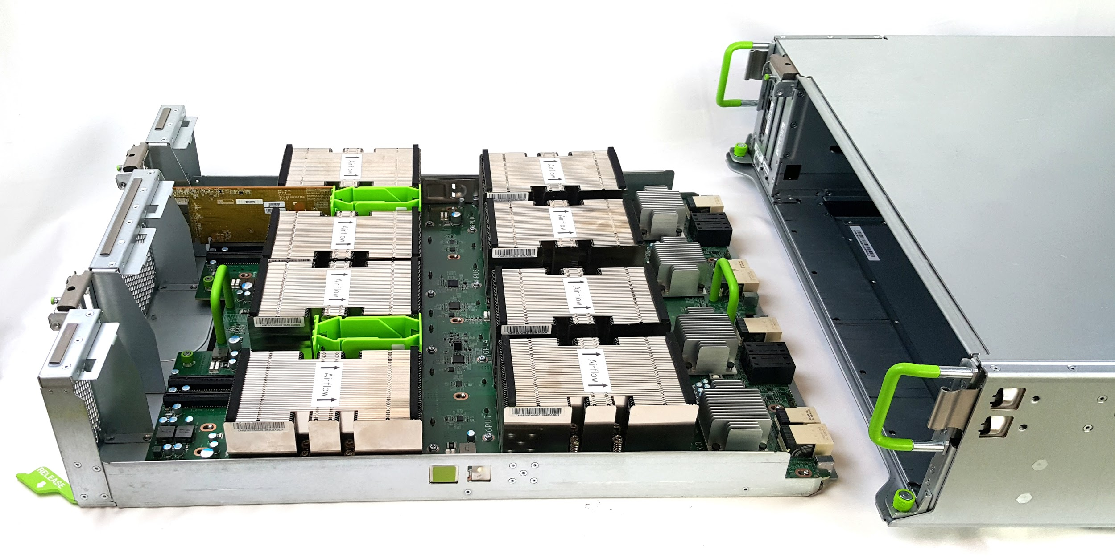
CORE IDEA OVERKILL?
Batch
NN

Slide 8
CORE IDEA OVERKILL?
Batch
NN

Slide 9
COME ON
Who would train one model on 256 GPUs?

Slide 10
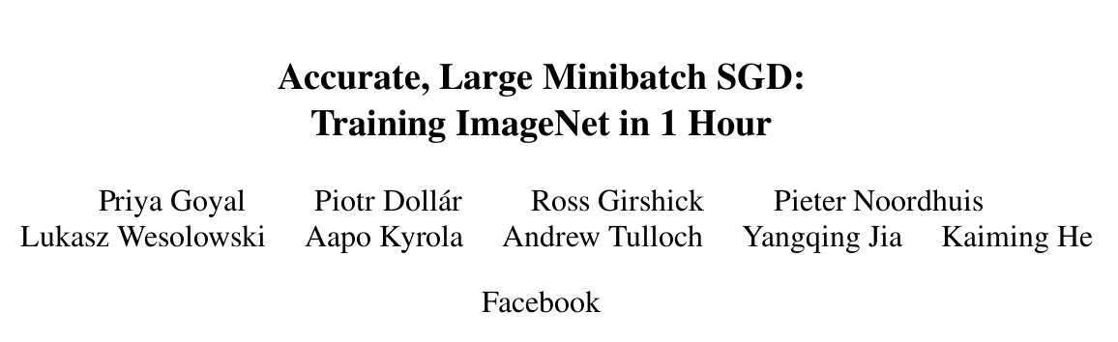

Slide 11
ResNet50

Slide 12
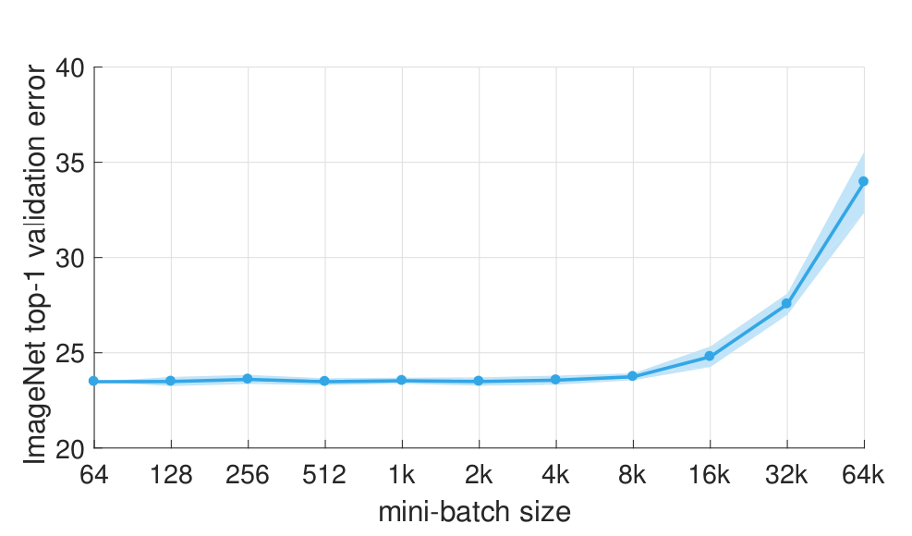

Slide 13
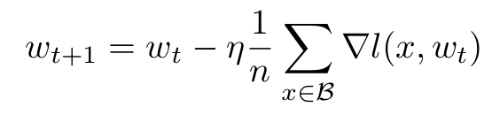
STEP 1
When the minibatch size is multiplied by k, multiply the learning rate by k

Slide 14
STEP 1
When the minibatch size is multiplied by k, multiply the learning rate by k… except
During the initial epoch - Instead gradually increase the learning rate from η to kη during the first 5 epochs
When the minibatch size gets too large…
Realistically, if you’re in this room, you won’t run into this issue.
If you do, can I have some GPUs?

Slide 15
STEP 2
Make sure the loss function normalizes wrt the total batch size.
Easiest and most efficient way is to sum everything into 1 set of gradients, then scale it.

Slide 16
STEP 3
Shuffle data every epoch across all workers.

Slide 17
STEP 4
If you’re using Batch Norm, things get messy
Do Batch Norm per GPU, not per mini batch

Slide 18
STEP 5
Double check weight decay and momentum
Don’t scale weight decay by the learning rate (make sure you scale the actual loss but don’t scale the weight decay loss)
Don’t scale momentum by the learning rate. Apply momentum correction after changing the learning rate of the loss.

Slide 19
STEP 6
Find a deep learning package that does all the system engineering for you.
Distributed Tensorflow
Caffe2
MXNet
Pytorch?

Slide 20
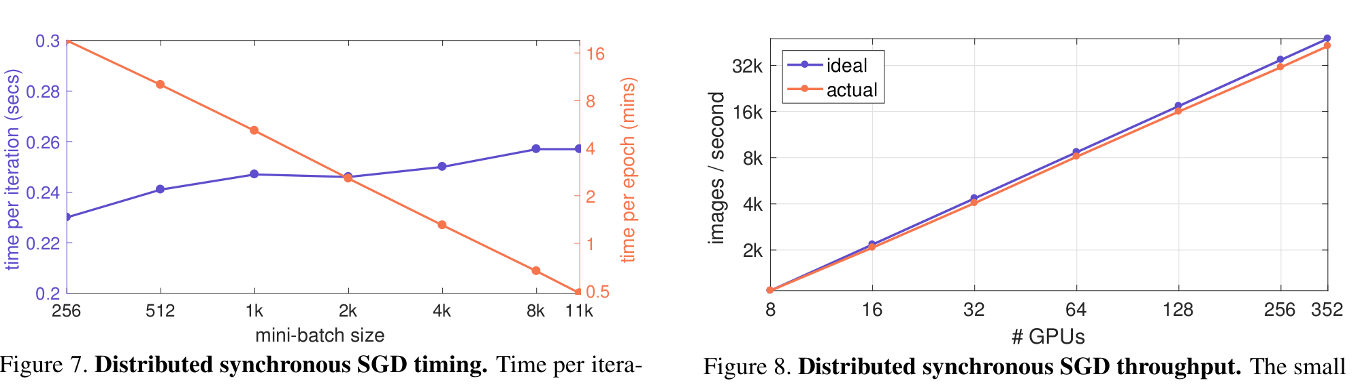
STEP 7
Don’t tell your boss, and take the rest of the month off*
*don’t do this

Slide 21
GOALS
Minimize Training Time
Maximize Throughput - Good for large datasets
Maximize Concurrency - Good for large clusters
Minimize Data Transfers
Maximize Batch Size - Good for when small batches are unstable
Maximize Network Depth
Minimize Latency - Good for deployment

Slide 22
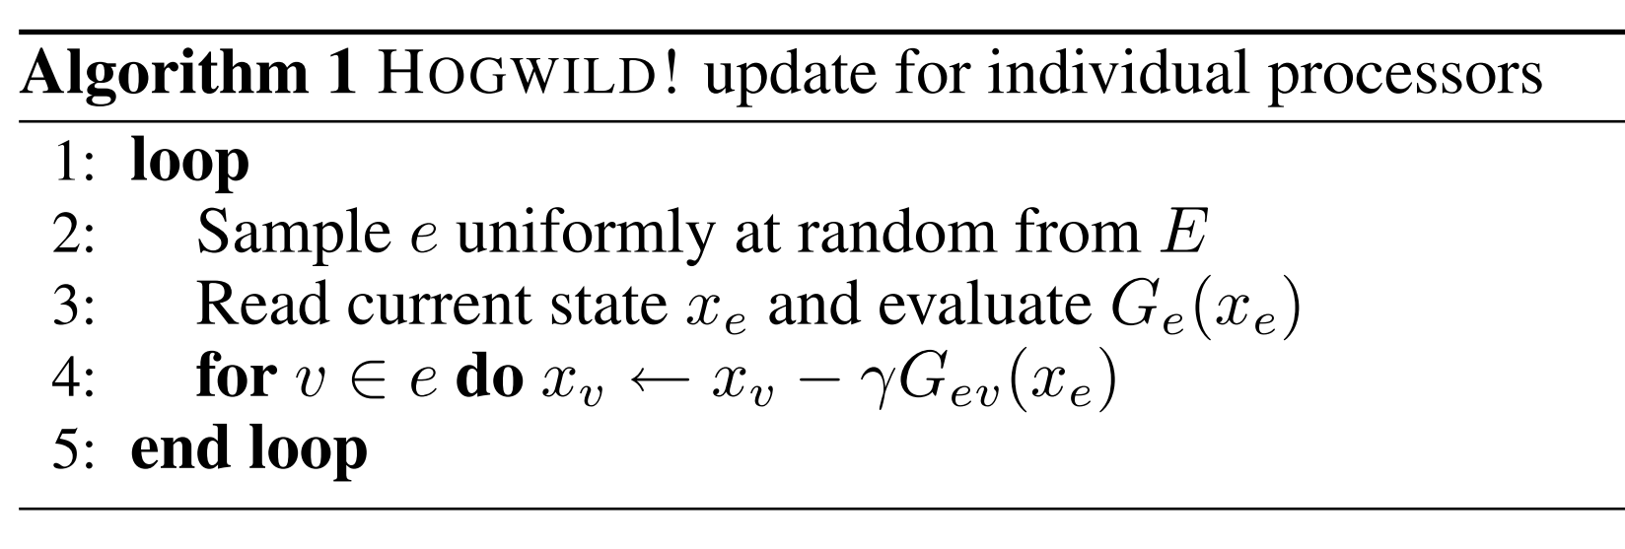
HOGWILD!

Slide 23
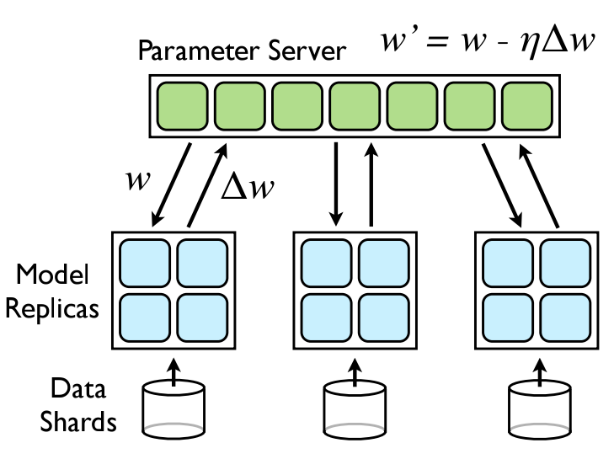
A3C-STYLE APPROACH

Slide 24
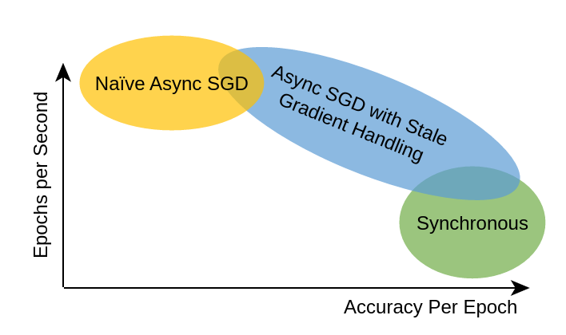
http://engineering.skymind.io/distributed-deep-learning-part-1-an-introduction-to-distributed-training-of-neural-networks

Slide 25
TRADEOFFS
Synchronous
More Stable
(Probably) faster convergence
Asynchronous
Easier to implement correctly
Easier to scale
Faster per sample (more concurrent)

Slide 26
GOALS
Minimize Training Time
Maximize Throughput - Good for large datasets
Maximize Concurrency - Good for large clusters
Minimize Data Transfers
Maximize Batch Size - Good for when small batches are unstable
Maximize Network Depth
Minimize Latency - Good for deployment - Distributed doesn’t actually matter.

Slide 27
Personal Experience
Use (Py)Torch for single machine synchronous parallelism.
Tensorflow works well for asynchronous parallelism, but is a pain for simple multi-gpu synchronous.

Slide 28
